Slide 1
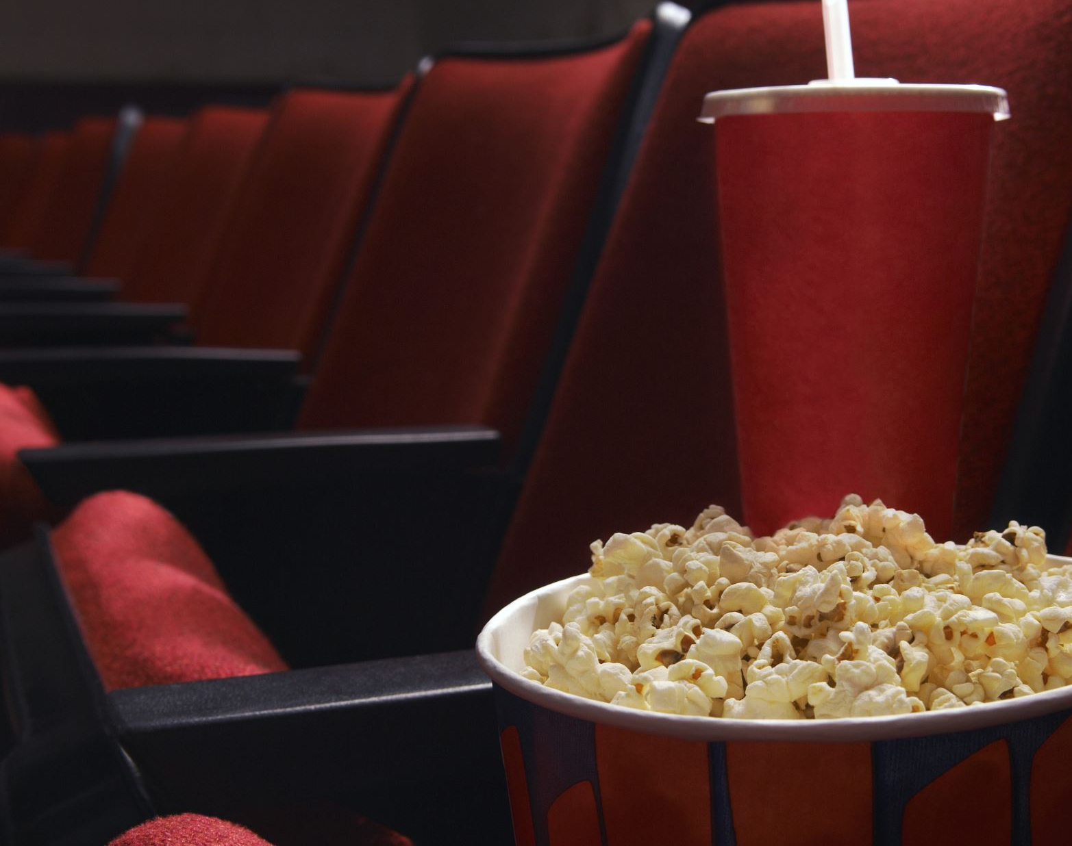
IMDB Movie Data
Data Engineering Track
Created by:
April Johnson
Trevor McDonough
Randy Silvey

Slide 2
Project Overview
Ethical Considerations
Data from IMDB
ETL: Extract, Transform and Load
Mongo Collection
Python read Collection
>Import Flask
HTML Format Webpage

Slide 3
Ethical Considerations
Subsets of IMDb data are available for access to customers for personal and non-commercial use. You can hold local copies of this data, and it is subject to our terms and conditions.
Limited non-commercial use of IMDb data is allowed, provided the following conditions are met:
You agree to all the terms of our copyright/conditions of use statement. Please also note that IMDb reserves the right to withdraw permission to use the data at any time at our discretion.
The data must be taken only from the datasets made available (see IMDb Contributor Datasets . You may not use data mining, robots, screen scraping, or similar online data gathering and extraction tools on our website. If the information/data you want is not present in our datasets, it means it's not available for non-commercial usage.
The data can only be used for personal and non-commercial use and must not be altered republished resold repurposed to create any kind of online/offline database of movie information (except for individual personal use). Please refer to the copyright/license information enclosed in each file for further instructions and limitations on allowed usage.
You must acknowledge the source of the data by including the following statement: Information courtesy of IMDb (https://www.imdb.com). Used with permission.
We reserve the right to deny any individual request for any reason.

Slide 4
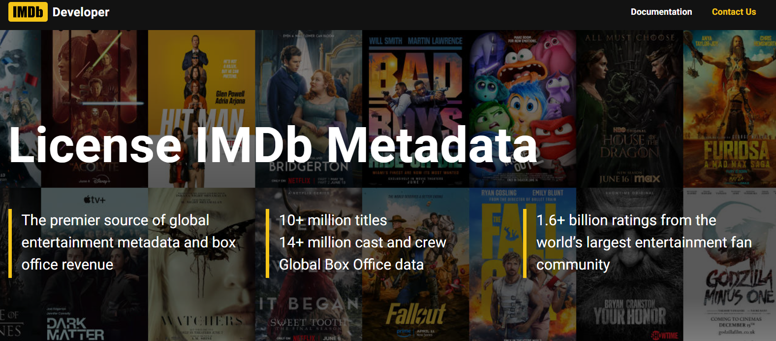
IMDB Website IMDb Non-Commercial Datasets
name.basics.tsv.gz
title.akas.tsv.gz – Title Constant & Title
title.basics.tsv.gz – Title Constant & Genres
title.crew.tsv.gz
title.episode.tsv.gz
title.principals.tsv.gz
title.ratings.tsv.gz – Title Constant

Slide 5
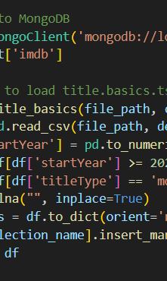
ETL: Extract, Transform and Load
Manually downloading database from IMDB
Used Python to import pymongo
Create collections of each data set

Slide 6
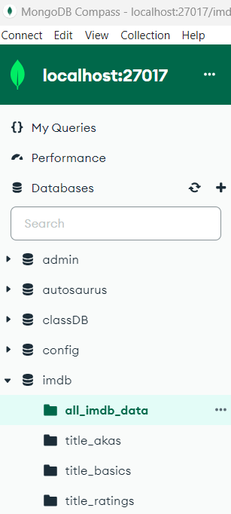
Mongo Collection
Collections Transformed
Data frames Merged with ‘inner’ join
Load merged Data frame into Mongo DB
Final collection “all_imdb_data” created from the initial 3 data sets

Slide 7
Python read Collection >Import Flask
Final collection from MongoDB
Only pull in US Region and Movies >=2023
Filter out TV shows & Adult Section
Flask API convert to JSON format

Slide 8
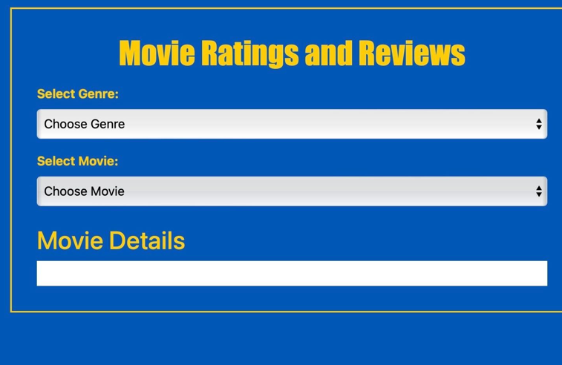
HTML Format Webpage

